Slide 1


.
.
Raleigh Tradeshow

Slide 2
Who is Easterseals UCP
A health non-profit organization operating in North Carolina, and parts of Virginia.
It has a goal of assisting people with disabilities to maximize their potential for living, learning, working and playing within the community.
Also, it is an affiliate of both Easterseals and UCP national networks, but operates independently and autonomously

Slide 3



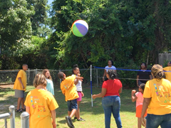
Primary Service Offered
Autism spectrum Disoder Service
Mental health disorders
Bipolar disorder
Youth Empowerment and Transitions

Slide 4
Sources of Finance
private insurers
Government agencies
grants,
subsidized fee-for-service
public contributions

Slide 5



How to Become Involved
Event partners
Fundraisers
volunteers

Slide 6
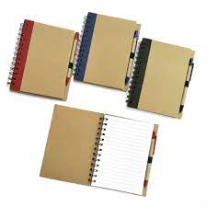
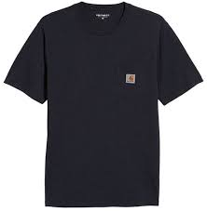
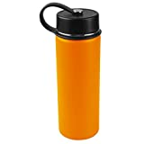
First Three Volunteers’ Giveaways
Branded Water Bottles
Branded note books
Branded T-Shirts

